Slide 1
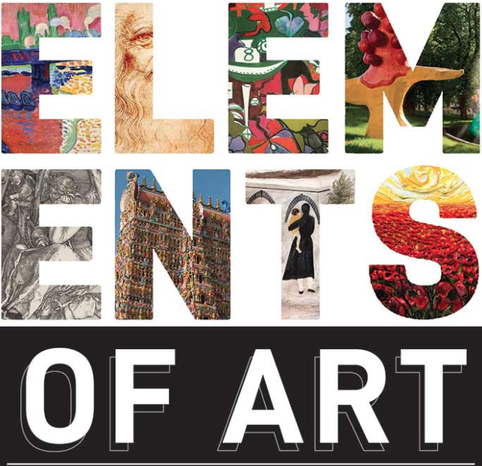
Taster Sessions: Task 2
A Level Photography
Transition from year 11 to year 12

Slide 2
Task 2 (WEEK 4)
Log into our new Art & Design Website ta-artanddesign.com and take a look around the KS5 Photography sections. The password to access this area is ART&DESIGN2020
WHAT ARE THE ELEMENTS AND PRINCIPLES OF ART/PHOTOGRAPHY?
The elements of art and principles of design are the fundamental pieces that make up an artwork, be it a painting or a photograph. Most works of art will make use of many or all of the elements and principles of art.
The elements of art are the building blocks of an artwork: color, line, shape, form, value, texture, and space. They are the tools artist’s use when creating an art/photographic artwork.
TASK 2: PHOTO SAFARI
With either your camera or a phone camera, try and capture a number of photographs that capture the first 4 elements of design.
4 photographs that describe space.
4 photographs that describe texture
4 photographs that describe shape.
4 photographs that describe form .
If you do struggle with any of the tasks set, please don’t hesitate to email Mr Haring and Ms Lynch for advice.

